Slide 1
Десктоп и приложна виртуализация
(Desktop and Application Virtualization)

Slide 2
Desktop виртуализация
Desktop virtualization is a method of simulating a user workstation so it can be accessed from a remotely connected device. By abstracting the user desktop in this way, organizations can allow users to work from virtually anywhere with a network connecting, using any desktop laptop, tablet, or smartphone to access enterprise resources without regard to the device or operating system employed by the remote user.

Slide 3
Предимства
Resource Utilization
Remote Workforce Enablement
Security

Slide 4
Resource Utilization
Since IT resources for desktop virtualization are concentrated in a data center, resources are pooled for efficiency. The need to push OS and application updates to end-user devices is eliminated, and virtually any desktop, laptop, tablet, or smartphone can be used to access virtualized desktop applications. IT organizations can thus deploy less powerful and less expensive client devices since they are basically only used for input and output.

Slide 5
Remote Workforce Enablement
Since each virtual desktop resides in central servers, new user desktops can be provisioned in minutes and become instantly available for new users to access. Additionally IT support resources can focus on issues on the virtualization servers with little regard to the actual end-user device being used to access the virtual desktop. Finally, since all applications are served to the client over a network, users have the ability to access their business applications virtually anywhere there is internet connectivity. If a user leaves the organization, the resources that were used for their virtual desktop can then be returned to centrally pooled infrastructure.

Slide 6
Security
IT professionals rate security as their biggest challenge year after year. By removing OS and application concerns from user devices, desktop virtualization enables centralized security control, with hardware security needs limited to virtualization servers, and an emphasis on identity and access management with role-based permissions that limit users only to those applications and data they are authorized to access. Additionally, if an employee leaves an organization there is no need to remove applications and data from user devices; any data on the user device is ephemeral by design and does not persist when a virtual desktop session ends.

Slide 7
Типове десктоп виртуализация
Virtual desktop infrastructure (VDI)
Remote desktop services (RDS)
Desktop-as-a-Service (DaaS)

Slide 8
VDI
VDI simulates the familiar desktop computing model as virtual desktop sessions that run on VMs either in on-premises data center or in the cloud. Organizations who adopt this model manage the desktop virtualization server as they would any other application server on-premises. Since all end-user computing is moved from users back into the data center, the initial deployment of servers to run VDI sessions can be a considerable investment, tempered by eliminating the need to constantly refresh end-user devices.

Slide 9
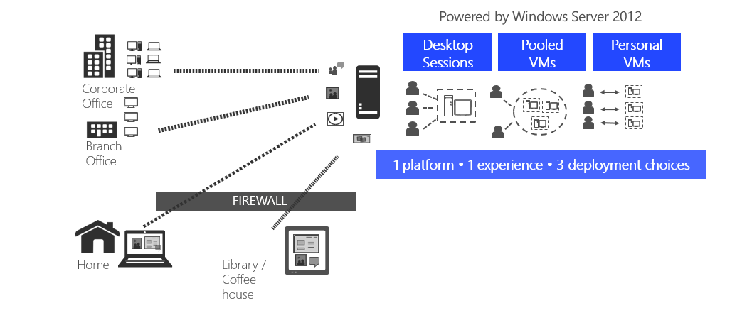
VDI

Slide 10
Persistent VDI
A user is assigned a standardized desktop from the resource pool the first time they log on.
Each subsequent time they access the VDI environment, they are connected to the same desktop with all of their changes retained in the virtual OS image - even after the connection is restarted.
For users with complex and fast-paced digital workflows, this means they can easily pick up where they left off and benefit from extensive personalization of the desktop’s virtual apps and settings.

Slide 11
Non-persistent VDI
The end client may be connected to the same desktop every time OR to a randomized one from the pool.
In either case, no changes are saved upon restarting.
Since nothing is saved once the connection is terminated, IT does not have to maintain a large number of customized OS images, allowing for simplified data center management and reduced costs.

Slide 12
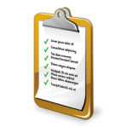

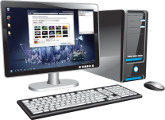
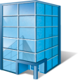


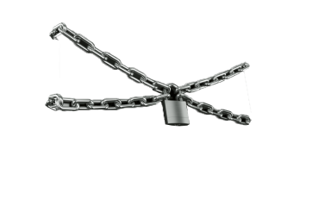

Scenarios for VDI
Provide a Managed Desktop to Unmanaged Devices
• Contract workers
• Employee-owned PCs and secondary devices.
Centralizing Desktop Management for Remote Locations
• Branch offices
• Offshore locations
Task Worker Scenarios
• Call center workers
• Shared terminals, such as factory kiosk / nursing stations
Desktops that Demand High Levels of Security and Compliance
• Non-mobile desktops in specific industries (i.e. financial services / healthcare / government)

Slide 13
RDS
RDS is often used where a limited number of applications need be virtualized, rather than a full Windows, Mac, or Linux desktop. In this model applications are streamed to the local device which runs its own OS. Because only applications are virtualized RDS systems can offer a higher density of users per VM.

Slide 14
RDS
RDS was originally called Terminal Services, which was a feature from Windows' legacy operating system, Windows NT. Citrix wrote and licensed the code for Terminal Services. RDS is limited to Windows Server, which means that users can only access Windows desktops. However, VDI is not limited to a single operating system or application architecture.

Slide 15
Benefits of RDS
Single point of maintenance.
Only one installation for many uses.
Reduced licensing expenditure.
Solid Security.
Lower Costs.

Slide 16
DaaS
DaaS shifts the burden of providing desktop virtualization to service providers, which greatly alleviates the IT burden in providing virtual desktops. Organizations that wish to move IT expenses from capital expense to operational expenses will appreciate the predictable monthly costs that DaaS providers base their business model on.

Slide 17
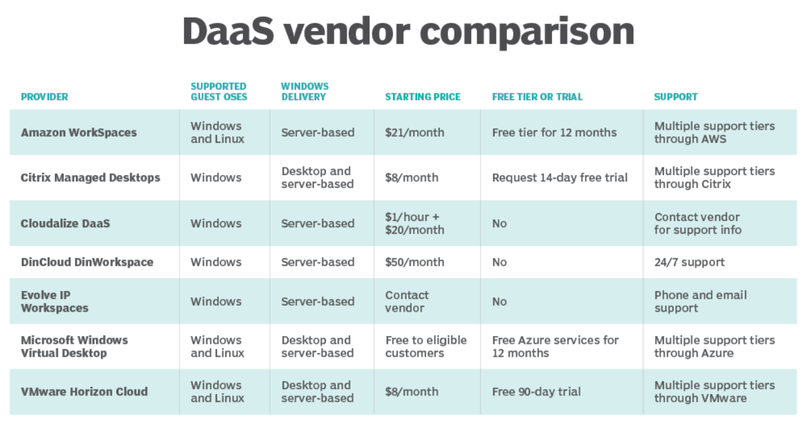
DaaS providers

Slide 18
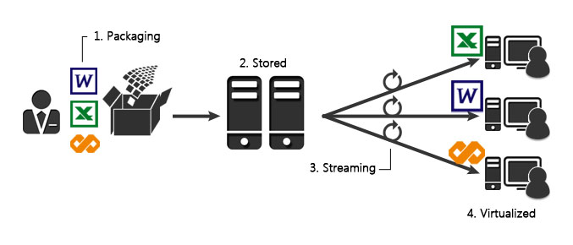
Application virtualization

Slide 19
Application virtualization
Allows the running of legacy apps (e.g., those developed for end-of-life OS platforms like Windows 7 and XP).
Enables cross-platform operations (e.g., running Windows apps on iOS, Android, macOS, and Chrome OS).
Prevents conflicts with other virtualized apps (e.g., conflicting anti-malware software).
Permits users to run multiple app instances—if not virtualized, many apps can detect the running of an instance and won't allow new ones.

Slide 20
Продукти
Citrix Virtual Apps and Desktops
Citrix XenApp
VMware Horizon
Microsoft HyperV
Windows Virtual Desktop (Azure)
Application Virtualization (App-V) for Windows

Slide 21
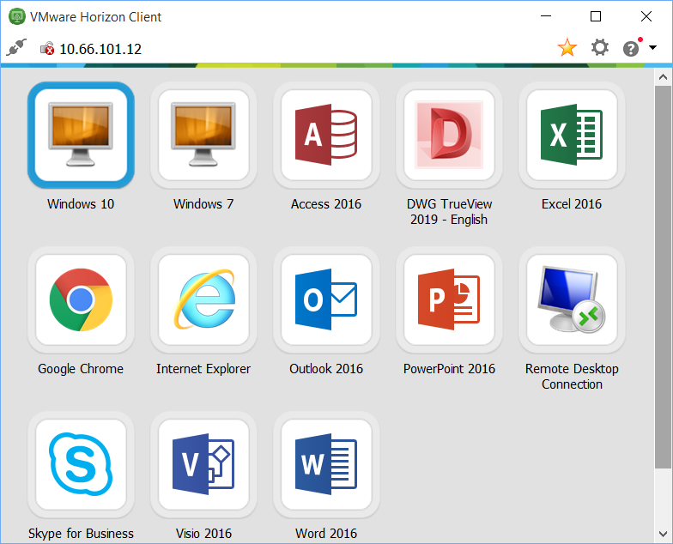
Real-life example

